Slide 1
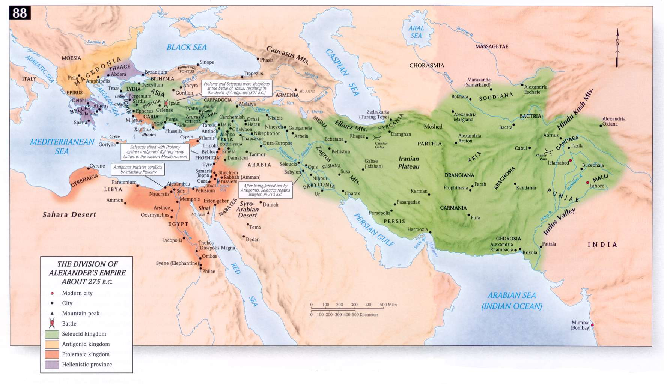
The Hellenistic World, 323 - 31 BC

Slide 2
Group Members
Class Period: <insert 1, 2, or 3 here>
Names:
<insert group member name here>
<insert group member name here>
<insert group member name here>

Slide 3
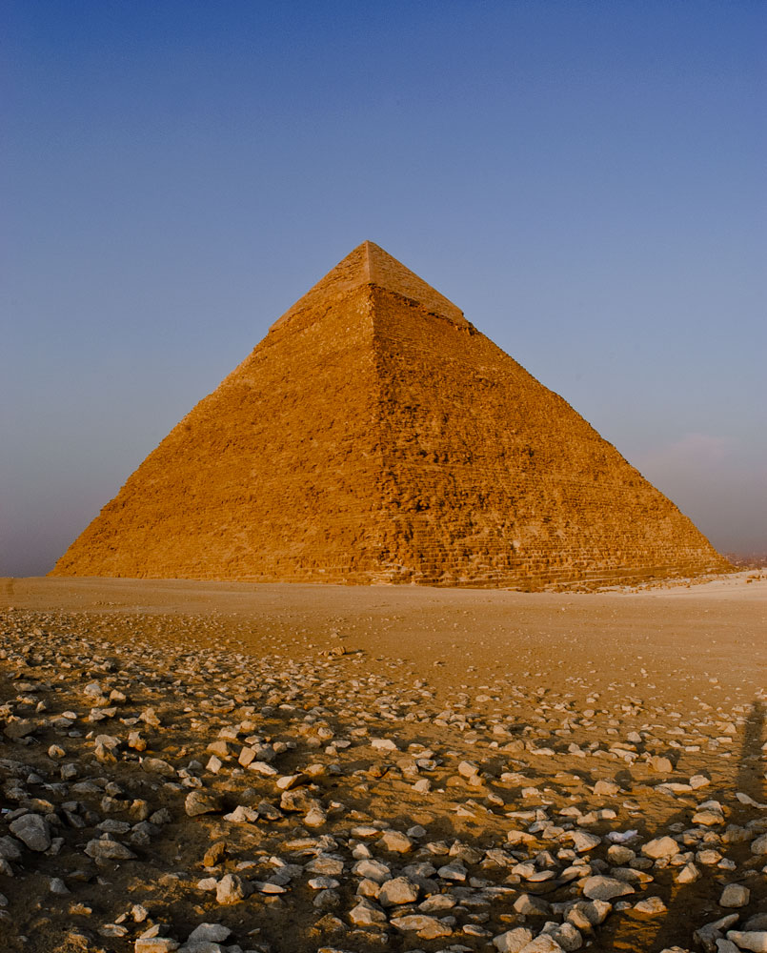
The Seven Wonders of the Ancient World
Great Pyramid of Giza
Where: Giza, Egypt
When: 2584–2561 BC
What: The tomb of Egyptian Pharaoh Khufu was the world’s tallest building for 3800 years. It is the only surviving ancient wonder.
Insert picture here

Slide 4
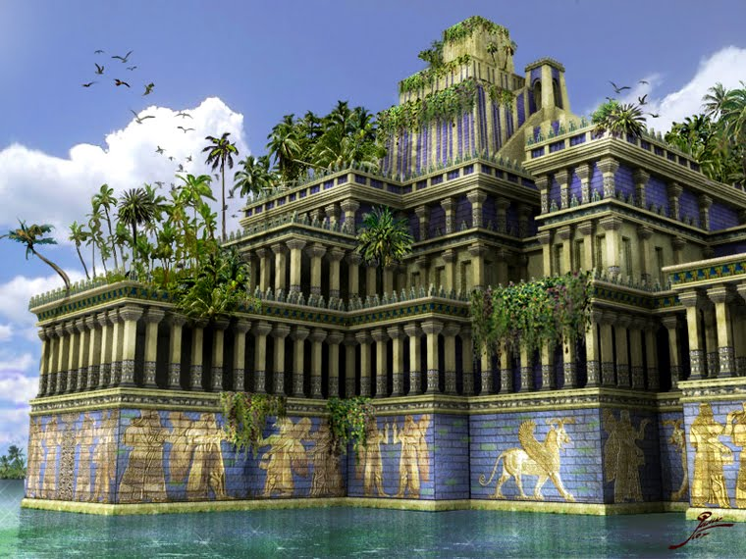
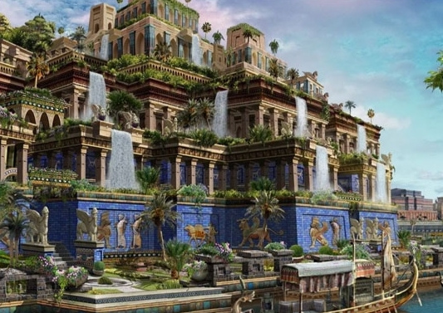
The Seven Wonders of the Ancient World
Hanging Gardens of Babylon
Where: Babylon, Mesopotamia
When: c. 600 BC
What: Nebuchadnezzar II built tiered gardens of trees, shrubs, and vines for his wife who missed her lush, green homeland. The location has not been found. Some doubt it truly existed. If it did, it was destroyed in ancient times.
Insert picture here

Slide 5
INTELLECT: Mathematics
Euclid
What he discovered:
Why he matters:
Insert picture here

Slide 6
INTELLECT: Mathematics
Archimedes of Syracuse
What he discovered:
Why he matters:
Insert picture here

Slide 7
INTELLECT: Mathematics
Hypatia
What she wrote:
Why she matters:
Insert picture here

Slide 8
INTELLECT: Astronomy
Aristarchus of Samos
What he discovered:
Why he matters:
Insert picture here

