Slide 1
The Hellenistic World, 323 - 31 BC

Slide 2
Group Members
Class Period: <insert 1, 2, or 3 here>
Names:
<insert group member name here>
<insert group member name here>
<insert group member name here>

Slide 3
The Seven Wonders of the Ancient World
Great Pyramid of Giza
Where: Giza, Egypt
When: 2584–2561 BC
What: The tomb of Egyptian Pharaoh Khufu was the world’s tallest building for 3800 years. It is the only surviving ancient wonder.
Insert picture here

Slide 4
The Seven Wonders of the Ancient World
Hanging Gardens of Babylon
Where: Babylon, Mesopotamia
When: c. 600 BC
What: Nebuchadnezzar II built tiered gardens of trees, shrubs, and vines for his wife who missed her lush, green homeland. The location has not been found. Some doubt it truly existed. If it did, it was destroyed in ancient times.
Insert picture here

Slide 5
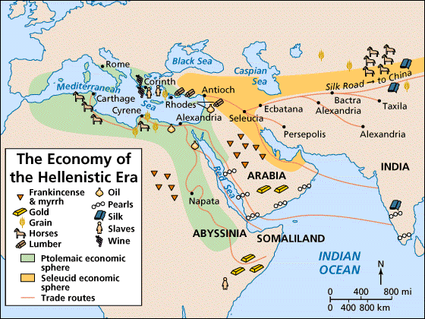
ECONOMICS: Trade
India: ivory, gold, ebony, pearls, cotton, spices and sugar
China: silk
Syria: wine
Egypt: papyrus, linen and glass
Greece: olive oil
Mesopotamia: dates and prunes
Spain: silver
Cyprus: copper
Britain: tin

Slide 6
ECONOMICS: Travel
Pytheas of Marseilles
Where he travelled:
Why it matters:
Insert picture here

Slide 7
ECONOMICS: Travel
Berosus of Babylon
What he wrote:
Why it matters:
Insert picture here

Slide 8
ECONOMICS: Travel
Manetho
What he wrote:
Why it matters:
Insert picture here

Slide 9
ECONOMICS: Travel
Megasthenes
What he travelled:
Why it matters:
Insert picture here

